Slide 1
Apache Cassnadra

Slide 2
Cassandra
Cassandra is a distributed, decentralized, fault tolerant, eventually consistent, linearly scalable, and column-oriented data store
It takes advantage of two proven and closely similar data-store mechanisms, namely Bigtable and Amazon Dynamo

Slide 3




The History of Cassandra
Bigtable
Dynamo

Slide 4



Apache Cassandra
Massively scalable, Open Source, NoSQL, distributed database built for modern, mission-critical online applications
Written in Java and is a hybrid of Amazon Dynamo and Google BigTable
Masterless with no single point of failure
Distributed and data center aware
100% uptime
Predictable scaling
High Performance
Multi Data Center
Time Series
Tunable Consistency
Simple to Operate
CQL language
Dynamo
BigTable
BigTable: http://research.google.com/archive/bigtable-osdi06.pdf
Dynamo: http://www.allthingsdistributed.com/files/amazon-dynamo-sosp2007.pdf

Slide 5
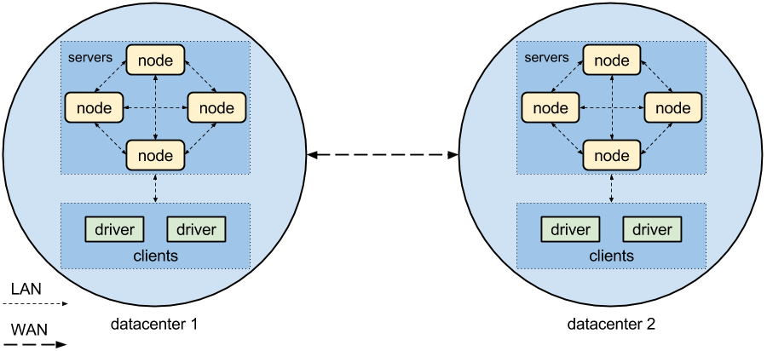
Cassandra Key Structures
Node
Datacenter
Cluster

Slide 6
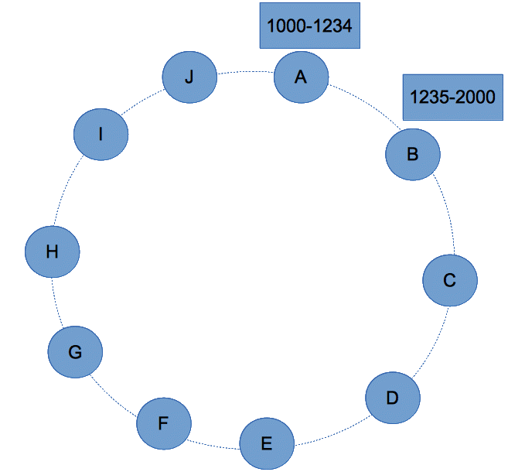

Slide 7
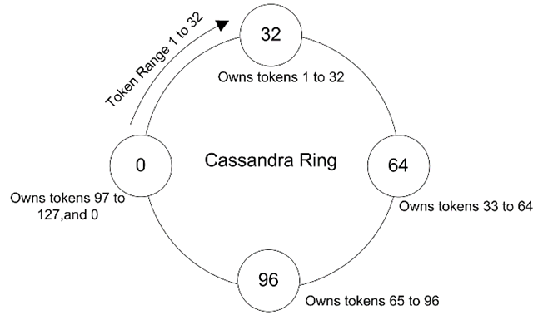
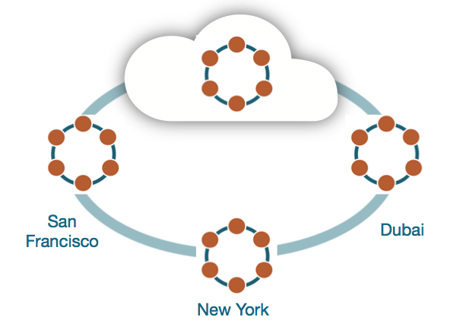
Ring representation
A Cassandra cluster is called a ring

Slide 8
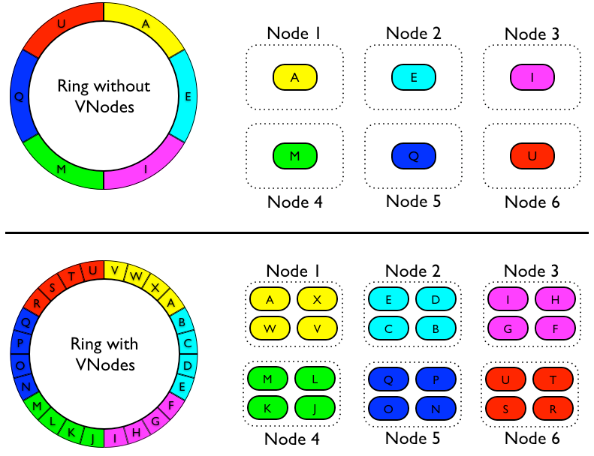
Virtual nodes

Slide 9
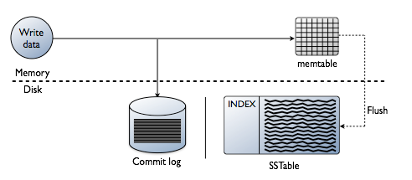
Write Path

Slide 10
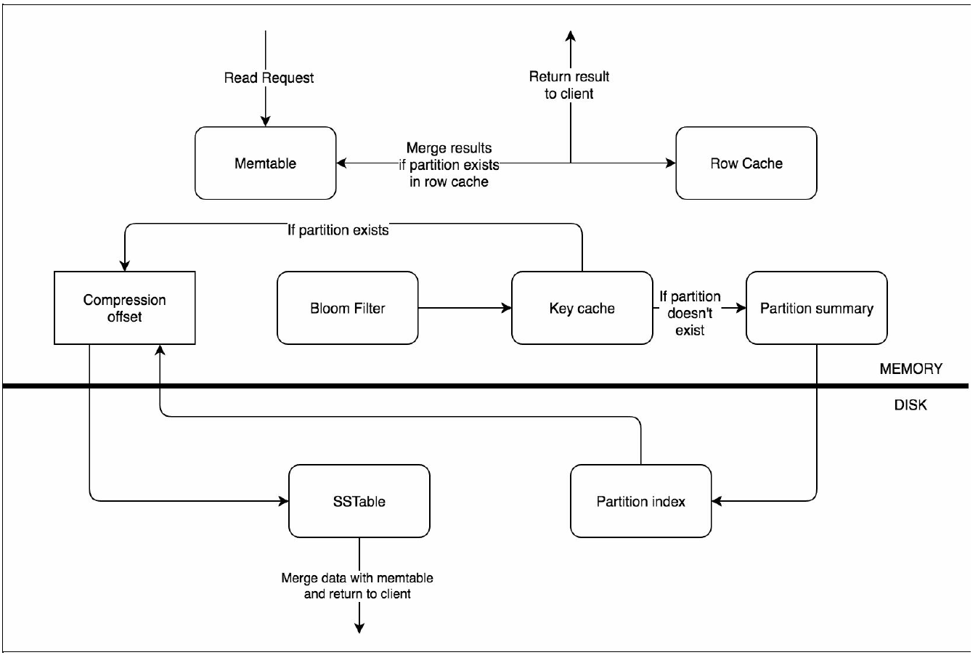
Read Path

Slide 11
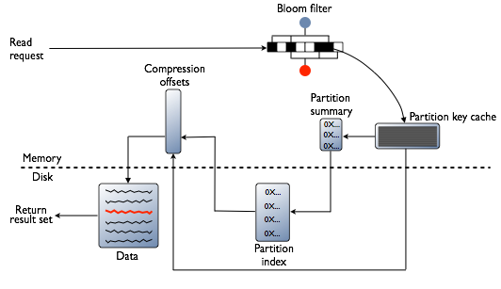
Read Path

Slide 12
Cassandra Data Modeling
Cassandra is not like well known RDBMS systems:
No a relational model
No foreign keys, no joins, no aggregations
Denormalization
Combine columns from different tables in a unique table (“materialized view”), no joins!
Don’t be afraid to duplicate data, to write data
Avoid joins at client level!

Slide 13
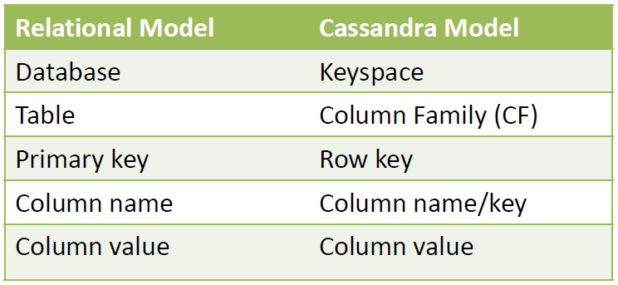
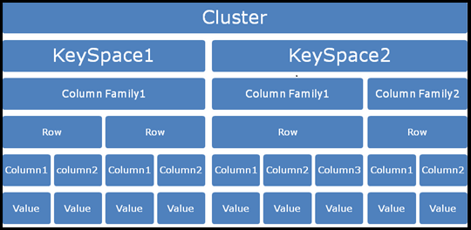
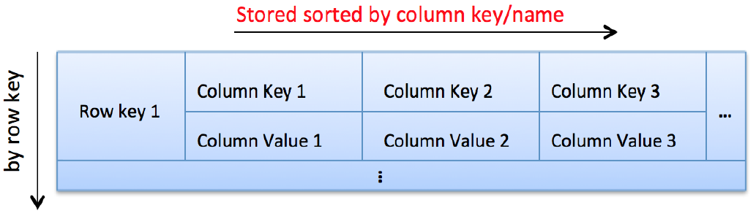
Intro to Cassandra Data Model

Slide 14
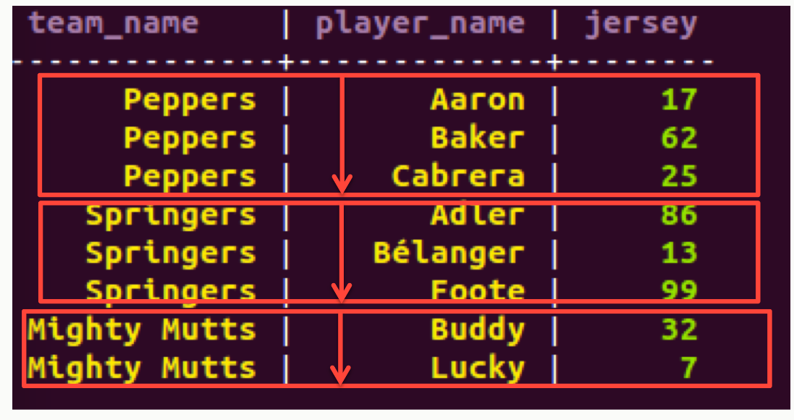
Cassandra Data Model
Based on Google Bigtable
Row-oriented column family
De-normalized
CREATE TABLE sporty_league (
team_name varchar,
player_name varchar,
jersey int,
PRIMARY KEY (team_name, player_name)
);
SELECT * FROM sporty_league;
The primary key uniquely identifies a row.
A composite primary key consists of:
A partition key
One or more clustering columns
e.g. PRIMARY KEY (partition key, cluster columns, ...)
The partition key determines on which node the partition resides
Data is ordered in cluster column order within the partition

Slide 15
CQL – Cassandra Query Language
Very similar to RDBMS SQL syntax
Core DML and DDL commands supported: INSERT, UPDATE, DELETE, SELECT, CREATE, GRANT …
INSERT INTO sporty_league (team_name, player_name, jersey) VALUES (’PSG',’Zlatan’,10);
SELECT player_name as nom_joueur FROM sporty_league WHERE team_name = ‘PSG’;
Data type : BLOB, UUID, TIMEUUID, User Defined Type …
User Defined Functions, User Defined Aggregates
Collections : Map, List, Set
TTL (Time-To-Live) at column level
Counters
Batch statements
Secondary Index

Slide 16
Installation
Download Cassandra
http://cassandra.apache.org/download/
Extract on Nodes
Tar xvf apache-cassandra-3.11.0-bin.tar.gz
Config it!
Cassandra.yaml file
Cassandra-env.sh file
Run it!
Cassnadra -f

Slide 17
Cassandra Config Properties
Cluster_name
(Default: Test Cluster) The name of the cluster. This setting prevents nodes in one logical cluster from joining another. All nodes in a cluster must have the same value.
listen_address
(Default: localhost) The IP address or hostname that Cassandra binds to for connecting this node to other nodes.
listen_interface
(Default: eth0) The interface that Cassandra binds to for connecting to other Cassandra nodes
Seeds
internal IP address of each seed node
Rpc_address
Listen address for client connections

Slide 18
Cassandra Data Directories
commitlog_directory
The directory where the commit log is stored.
data_file_directory
The directory location where table data is stored (in SSTables).
As a production best practice, use RAID 0 and SSDs
saved_caches_directory
The directory location where table key and row caches are stored.

Slide 19
Installing Cassandra!

Slide 20
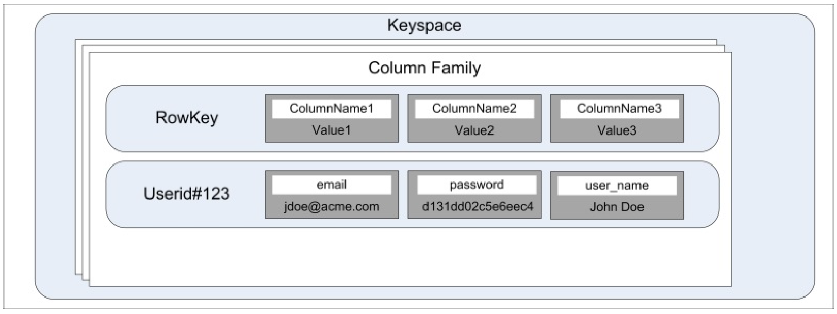
Cassandra Data Modeling
Cassnadra is a distributed, nested, sorted hash map where the outer sorted hash map is distributed across the machines and the inner one stays on one machine.

Slide 21
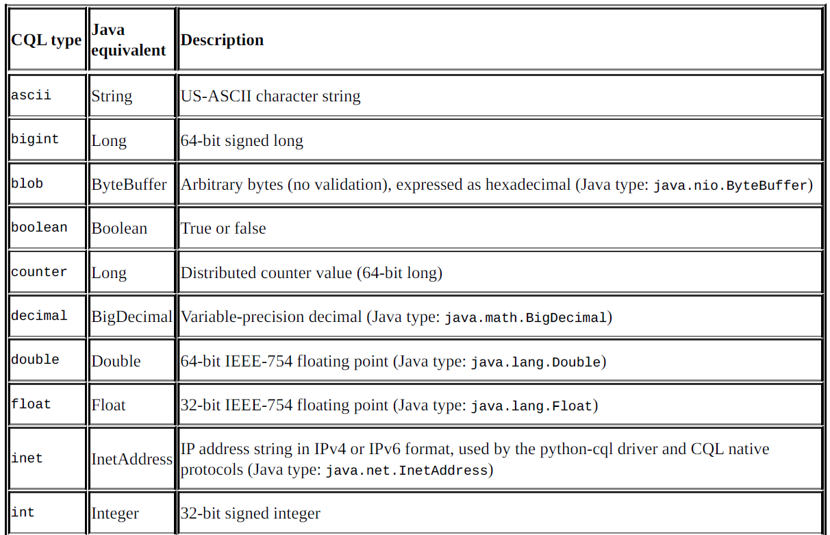
Data types

Slide 22
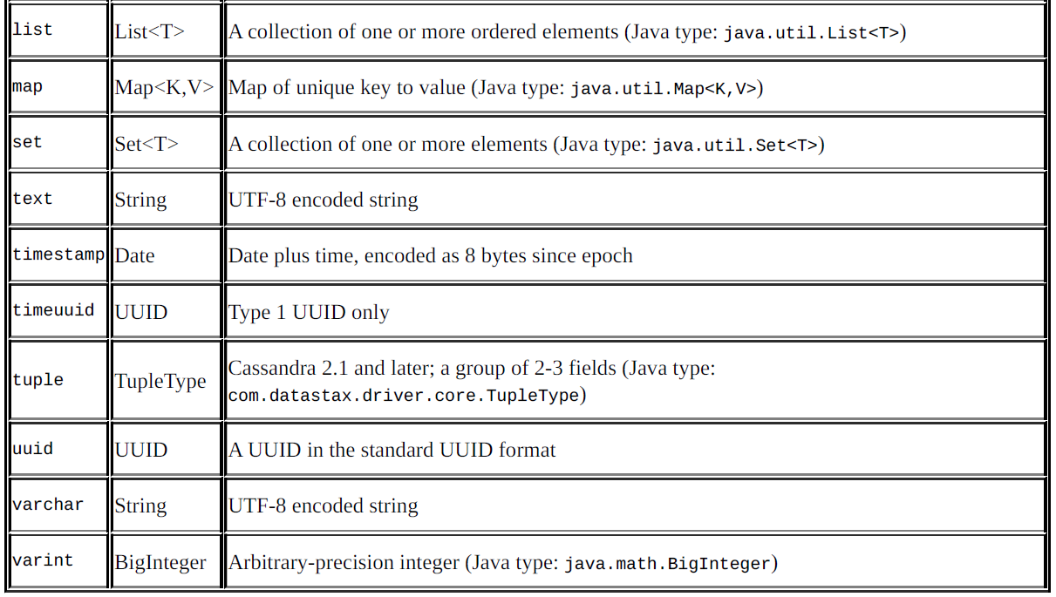
Data types

Slide 23
The primary index
Cassandra uses the partitioner (cluster-level setting) and replica placement strategy (keyspace-level setting) to locate the nodes that own a particular row.
Partitioners use a hash function to convert a row key into a unique number (called token) and then read/write happens from the node that owns this token

Slide 24
Creating a keyspace
specify how you want your data to be replicated across the nodes. There are two options to do this: SimpleStrategy and NetworkTopologyStrategy
Replication Factor
how would each node know which data center it belongs to?
Snitch

Slide 25
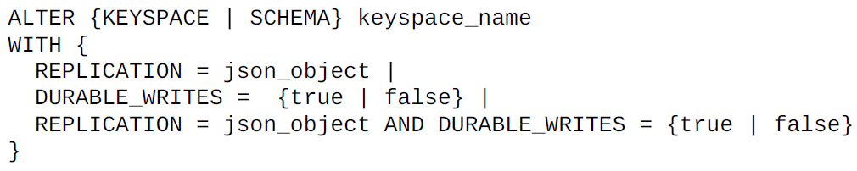
Altering a keyspace

Slide 26
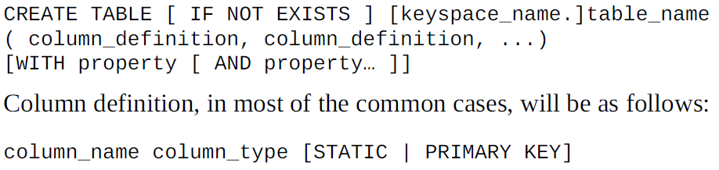
Creating a table

Slide 27
Counter Cell
A counter column is a special purpose cell to keep count.
A client application can increment or decrement it by an integer value.
Cannot mix counter and non counter columns in the same table.

Slide 28
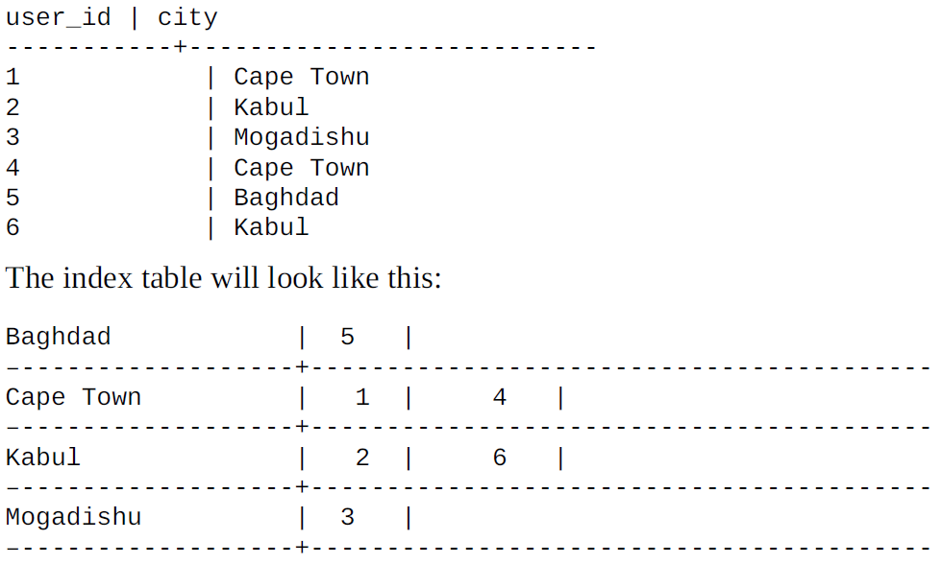
Secondary Index
you can create an index on a column after defining a table. You can also index a collection column. Secondary indexes are used to query a table using a column that is not normally queryable.

Slide 29
Secondary Index
why not just go ahead and create indexes for all the columns?
There are a couple of reasons to that.
First, indexes are not free. Indexes are maintained in separate columns’ families, and extra work is needed to be done every time one mutates a column that has an index on it.
The second thing is cardinality, which is true to the database indexes in general.
Avoid high cardinality columns for indexing
We have seen that high cardinality columns are not good for indexes and hence, we should avoid them.
Extremely low cardinality might not add any value
Extremely frequently updated or deleted columns are a bad choice
Notes:
Indexes tables are stored locally, which means an index table on node X will have an index created only for the rows that exist on node X. This means, every search that includes an indexed
column makes a query on the index table on all the nodes

Slide 30
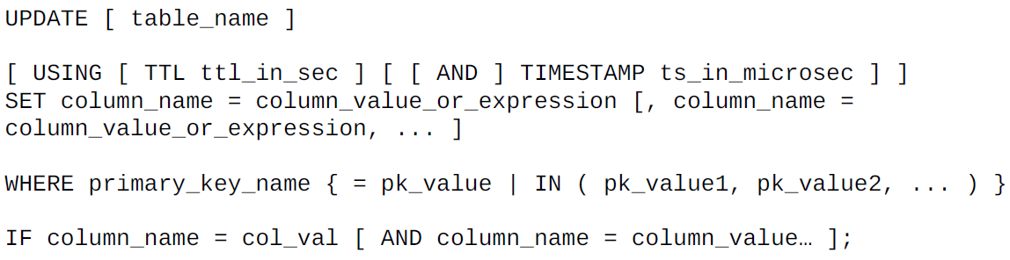
Updating a Row

Slide 31
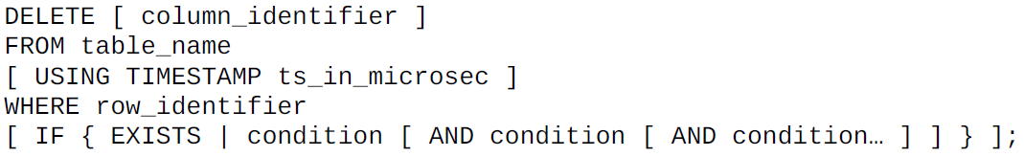
Delete a Row

Slide 32
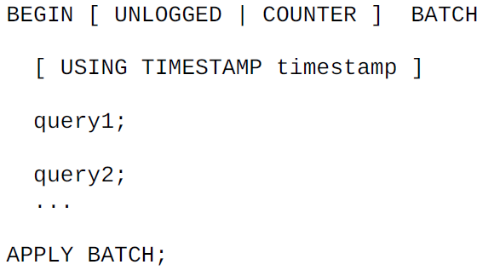
Executing the BATCH statement

Slide 33
Other CQL commands
USE
TRUNCATE
DESCRIBE
TRACING
CONSISTENCY
COPY
CAPTURE
ASSUME
SOURCE
SHOW
EXIT or QUIT

Slide 34
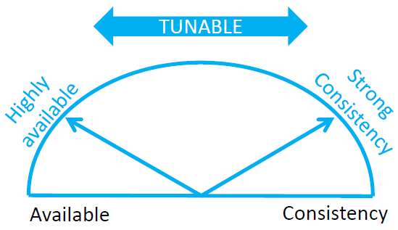
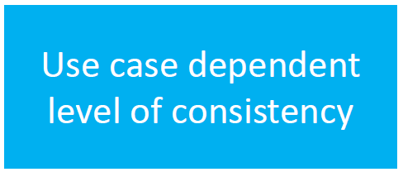
Tunable Consistency
Choose between strong and eventual consistency
Adjustable for read-and write-operations separately
Conflicts are solved during reads, as focus lies on write-performance

Slide 35
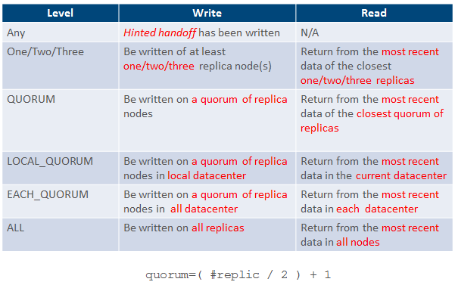
Tunable Consistency

Slide 36
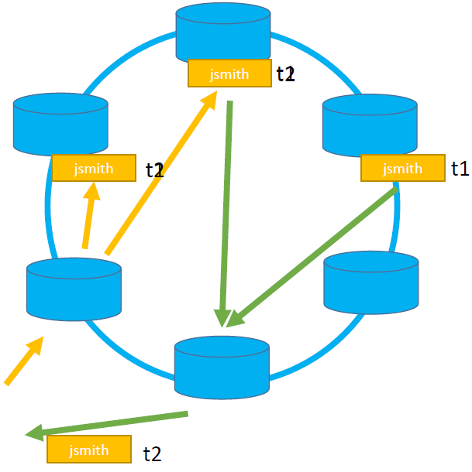
strong consistency
Simple Formula:
(nodes_written+ nodes_read) >replication_factor
Ensures that a read always reflects the most recent write
If not: Weak consistency >> Eventually consistent

Slide 37
Cassandra Component
Gossip
A peer-to-peer communication protocol to discover and share location and state information about the other nodes in a Cassandra cluster. Gossip information is also persisted locally by each node to use immediately when a node restarts
Partitioner
A partitioner determines which node will receive the first replica of a piece of data, and how to distribute other replicas across other nodes in the cluster.
Replication factor
The total number of replicas across the cluster.
Replica Placement Strategy
Cassandra stores copies (replicas) of data on multiple nodes to ensure reliability and fault tolerance.
Snitch
A snitch defines groups of machines into datacenters and racks (the topology) that the replication strategy uses to place replicas.

Slide 38
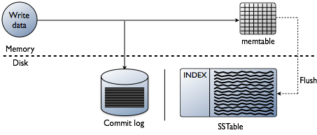
Cassandra Internal

Slide 39
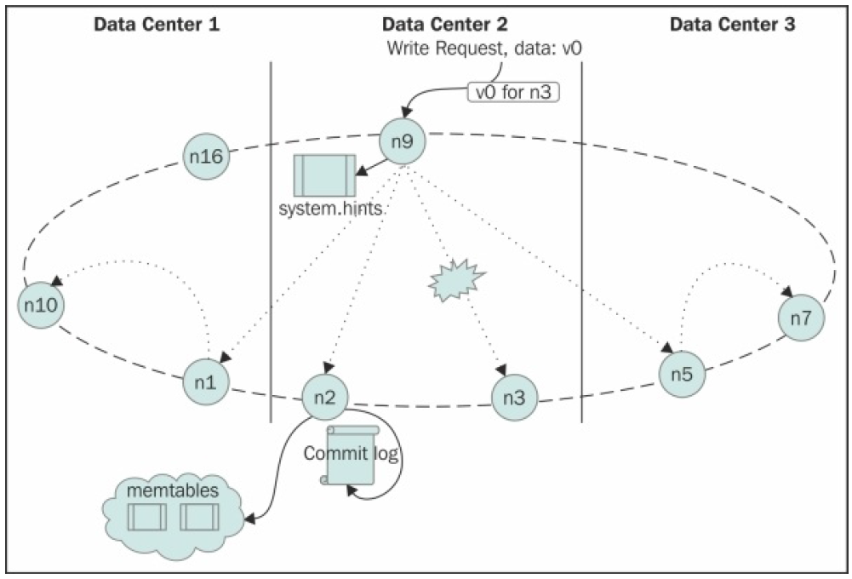
Write Request

Slide 40
Cassandra Component
Commit log
All data is written first to the commit log for durability. After all its data has been flushed to SSTables, it can be archived, deleted, or recycled
Memtable
Memtables are in-memory structures where Cassandra buffers writes. In general, there is one active memtable per table. Eventually, memtables are flushed onto disk and become immutable SSTables.
SSTables
SSTables are the immutable data files that Cassandra uses for persisting data on disk

Slide 41
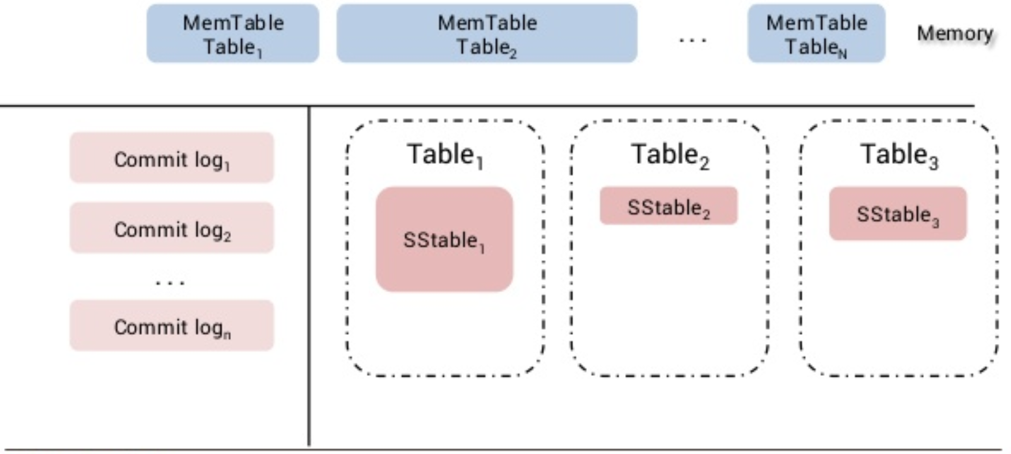
Cassandra Internal

Slide 42
Compaction
Cassandra performs compaction, which merges multiple SSTables and gets rid of extra data
Size-tiered compaction strategy (STCS): Size-tiered compaction is triggered when a certain number of SSTables of the same size exist for a single column family.
Leveled compaction strategy (LCS):Leveled compaction creates SSTables of fixed sizes that are grouped into levels called L0, L1, L2, and so on. New SSTables are placed in L0 and immediately compacted with SSTables in L1
Date-tiered compaction strategy (DTCS): Date-tiered compaction was introduced to be used with time series data. This compaction groups tables based on a certain time window and compacts those SSTables.

Slide 43
The read path
The different components used by Cassandra to process a read query:
Memtable
Row cache
Bloom filters
Key cache
Partition summary
Partition index
Compression offset map
SSTables

Slide 44
Memtable
This is the first stage in the read process. Cassandra initially checks whether the queried partition is present within memTable.
If it exists, Cassandra combines the data from memtable with data from SSTables and returns the result

Slide 45
Memtable
Memtables are not entirely off heap, but you can choose two options to reduce the heap memory footprint:
offheap_buffers moves the name and value of cell to DirectBuffer objects. This has the lowest impact on read performance and reduces the heap usage significantly only if you're storing large strings or blobs.
offheap_objects moves the entire cell to off heap, leaving only a pointer (to the cell) on heap. This is useful when you're storing small values such as ints or UUIDs. The data still has to be copied to heap memory before reading from it.

Slide 46
Row cache
The row cache, if enabled, stores a subset of the data on SSTables in memory.
This is particularly useful for read-heavy workloads.
Row cache is stored fully off heap, and thus, it reduces the garbage collection pressure on the Cassandra JVM.
Enable a row cache only when the number of reads is much bigger (rule of thumb is 95%) than the number of writes

Slide 47
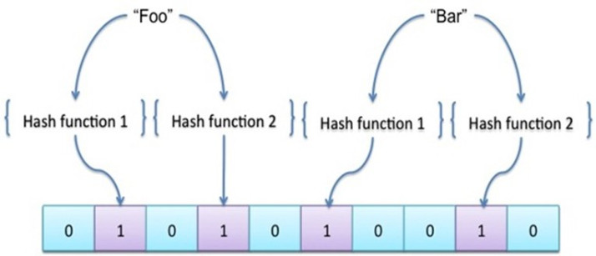
Bloom filter
Cassandra checks the bloom filter to get all the SSTables where the partition might exist
A bloom filter is a probabilistic data structure that is used to figure out if a partition key exists on the SSTable or not
https://prakhar.me/articles/bloom-filters-for-dummies/

Slide 48
Key cache
Key cache is an off-heap memory structure that stores the partition index.
If a partition key is present within the key cache, the read process skips partition summary and partition index and goes directly to the compression offset map.

Slide 49
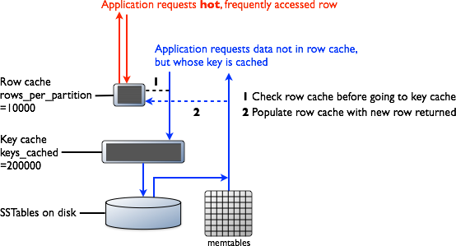
Row cache and Key cache request flow

Slide 50
Partition summary
If a partition key is not present within the key cache, the read process hits the partition summary next.
The partition summary is an off-heap memory component that stores a sampling of the partition index.

Slide 51
Partition index
The partition index resides on disk and stores an index of all partition keys mapped to their offset.
Searching a partition index involves a disk seek and sequential read.

Slide 52
Compression offset map
The compression offset map stores pointers to the location on disk, where the partition exists.
It is stored in off-heap memory and is accessed by either the partition key cache or the partition index.

Slide 53
Data Read Flow

Slide 54
Cassandra repair mechanisms
Hinted handoff
Read repair
Anti-entropy repair

Slide 55
Hinted handoff
Cassandra keeps a copy of the partitions that were supposed to be written to the unresponsive node within a local hints table.
When the downed node comes up and starts gossiping with the rest of the nodes in the cluster, the hints are replayed to the downed node, and data is back in sync between all the replica nodes.
The coordinator node will eventually evict hints if the downed node doesn't come back up within the eviction period. The coordinator also stops storing hints related to a downed node if it is down for a configurable period of time

Slide 56
Write Request

Slide 57
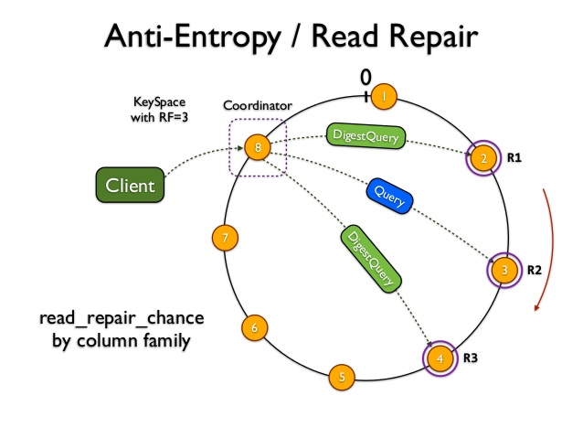
Read repair
Read repair is triggered during a read request.

Slide 58
Anti-entropy repair
Anti-entropy repair happens during major compaction.
Cassandra accomplishes anti-entropy repair using Merkle trees
Anti-entropy is a process of comparing the data of all replicas and updating each replica to the newest version.
Cassandra has three phases to the process:
Building a Merkle tree for each replica
Comparing the Merkle trees to discover differences
Streaming the relevant data

Slide 59
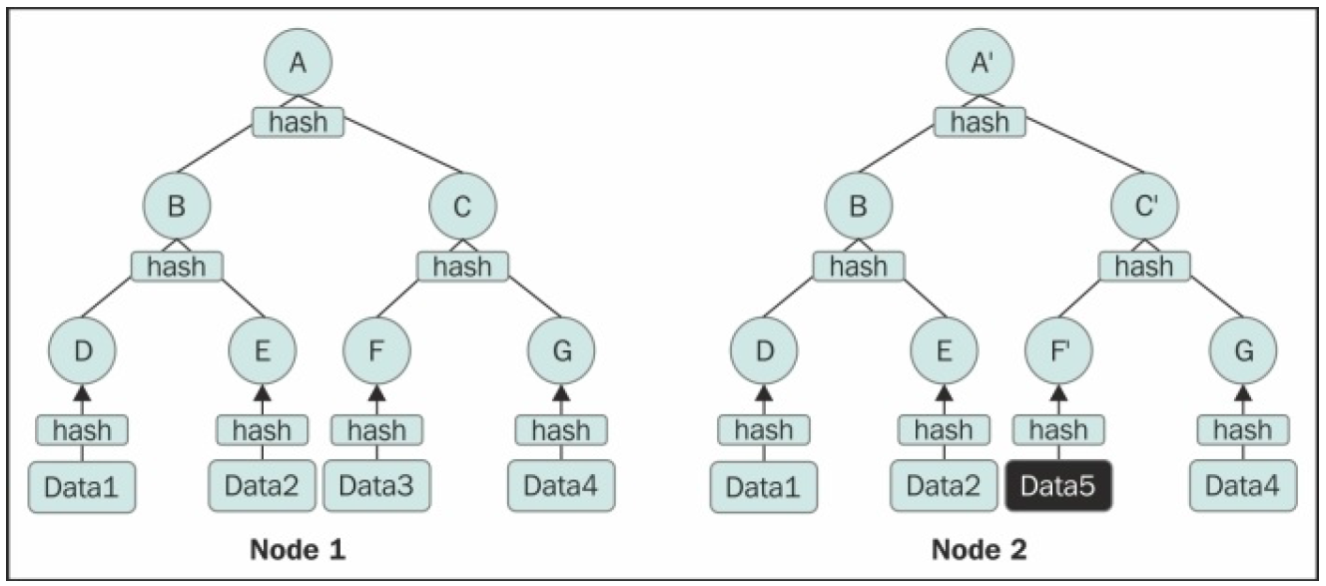
Merkle trees
Merkle trees are binary hash trees whose leaves are hashes of the individual key values. The leaf of a Cassandra Merkle tree is the hash of a row value.

Slide 60
Data Distribution in Cassandra
Cassandra tokens are signed 64-bit integers, so the minimum possible hash is -263 or -9223372036854775808, and the maximum possible hash is 263-1 or 9223372036854775807

Slide 61
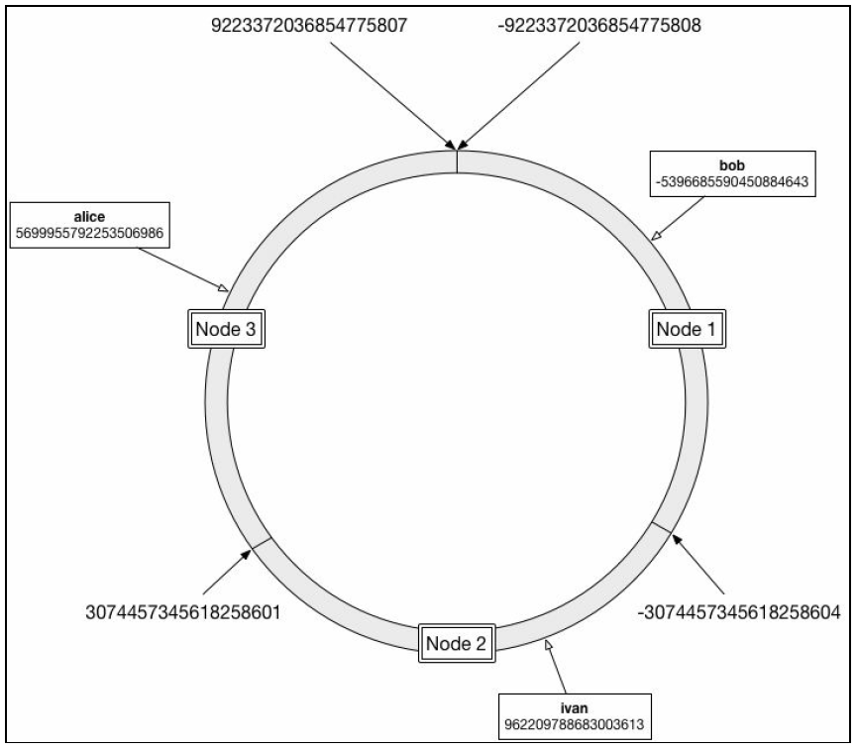
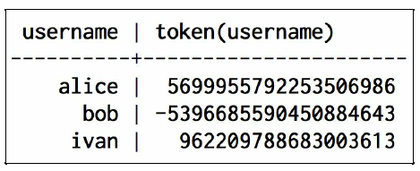
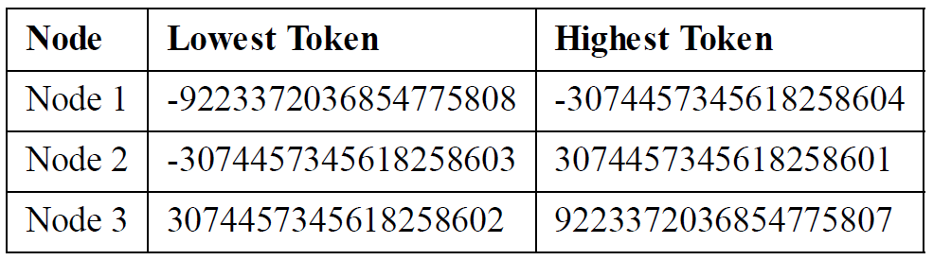
Data Distribution in Cassandra

Slide 62
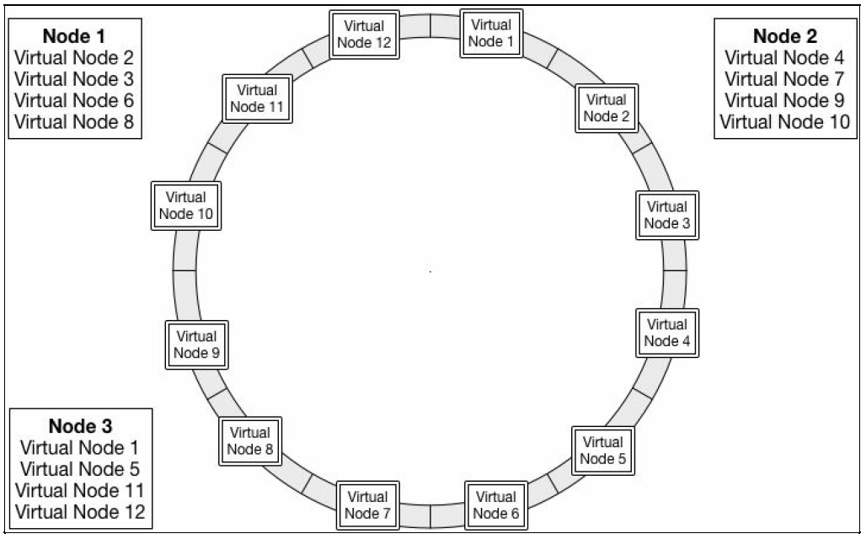
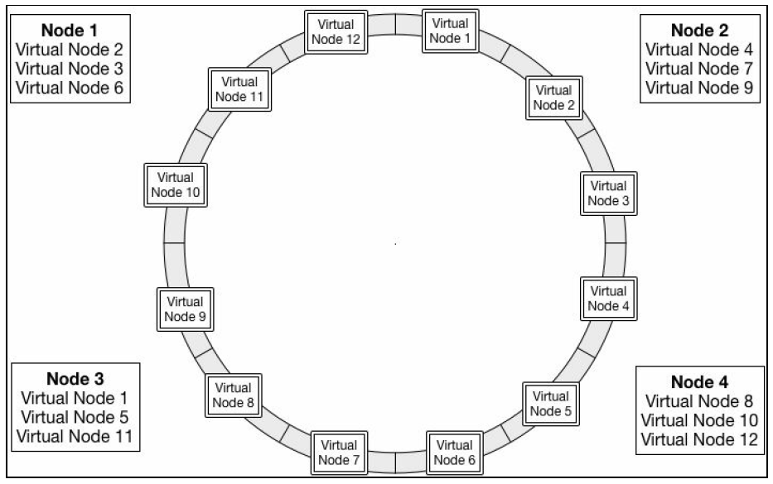
Virtual Nodes
The main advantage of virtual nodes is their behavior when the cluster changes.
When a new node joins the cluster, it's simply assigned a handful of virtual nodes that previously belonged to other machines

Slide 63
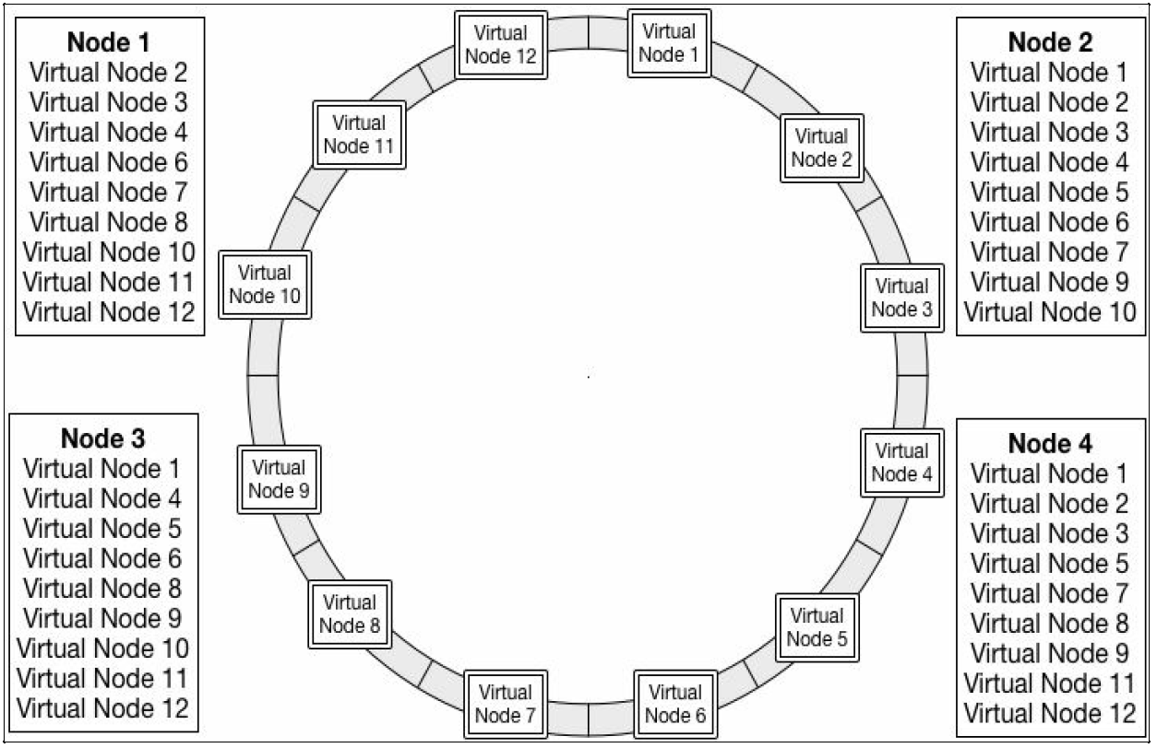
Virtual Nodes and Replication

Slide 64
Partitioner
The component that is responsible for generating the partition key hash is called the partitioner
Cassandra comes with three partitioners:
Murmur3Partitioner : distributes data across the cluster by calculating Murmur hash values
RandomPartitioner : distributes data by calculating MD5 hash values of the partition key.
ByteOrderedPartitioner : This partitioner keeps an ordered distribution of data lexically by key bytes.

Slide 65
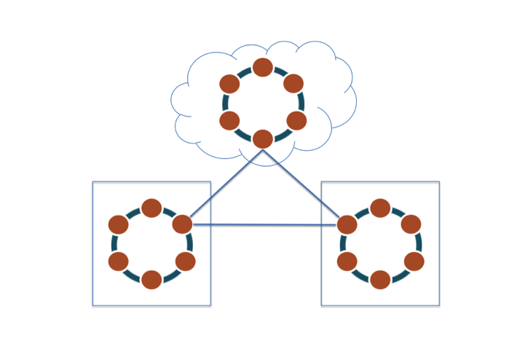
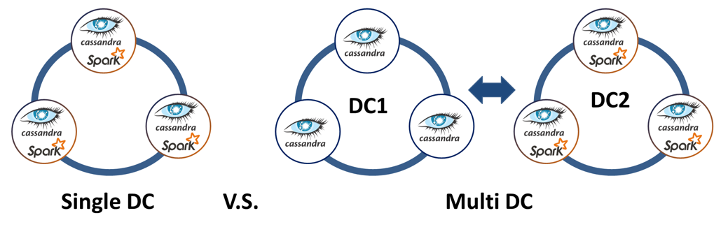
Multi datacenter cluster
Snitch
Replication Strategy
Keyspace

Slide 66
Snitch
A snitch determines the data center and rack configuration for the cluster.
For single data center setups, it is common to leave the snitch to a default value of SimpleSnitch.
For multi-data center setups, there are a bunch of snitches to select from depending on the networking setup and other factors.
PropertyFileSnitch reads the network configuration from the cassandra-topology.properties
GossipingPropertyFileSnitch : In this snitch, you will have to specify the data center and rack value of that particular node within the cassandra-rackdc.properties file

Slide 67
Replication strategy
Replication strategy determines how data is written to and read from Cassandra.
This is set at the keyspace level.
Together with replication factor, this guides the entire replication process of a keyspace.
SimpleStrategy: Place the original row on a node determined by the partitioner. Additional replica rows are placed on the new nodes clockwise in the ring.
NetworkTopologyStrategy: The original row is placed according the partitioner. Additional replica rows in the same data center are then placed by walking the ring clockwise until a node in a different rack from previous replica is found.

Slide 68
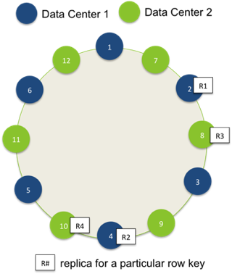
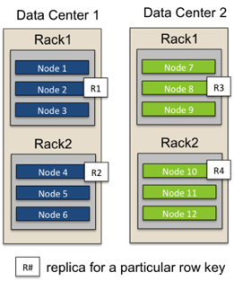
Replication - Network Topology Strategy
RF={DC1:2, DC2:2}

Slide 69
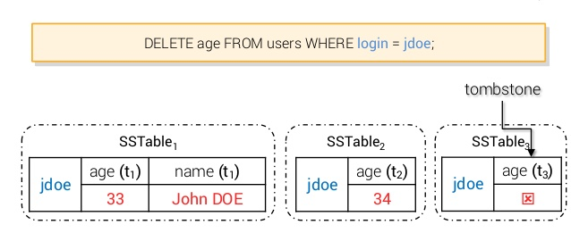
Distributed deletion
Deleting distributed and replicated data from a system such as Apache Cassandra is far trickier than in a relational database.
When a column is deleted, it is not removed from disk immediately. The deleted column is marked with a tombstone and then removed after the configured grace period has expired.

Slide 70
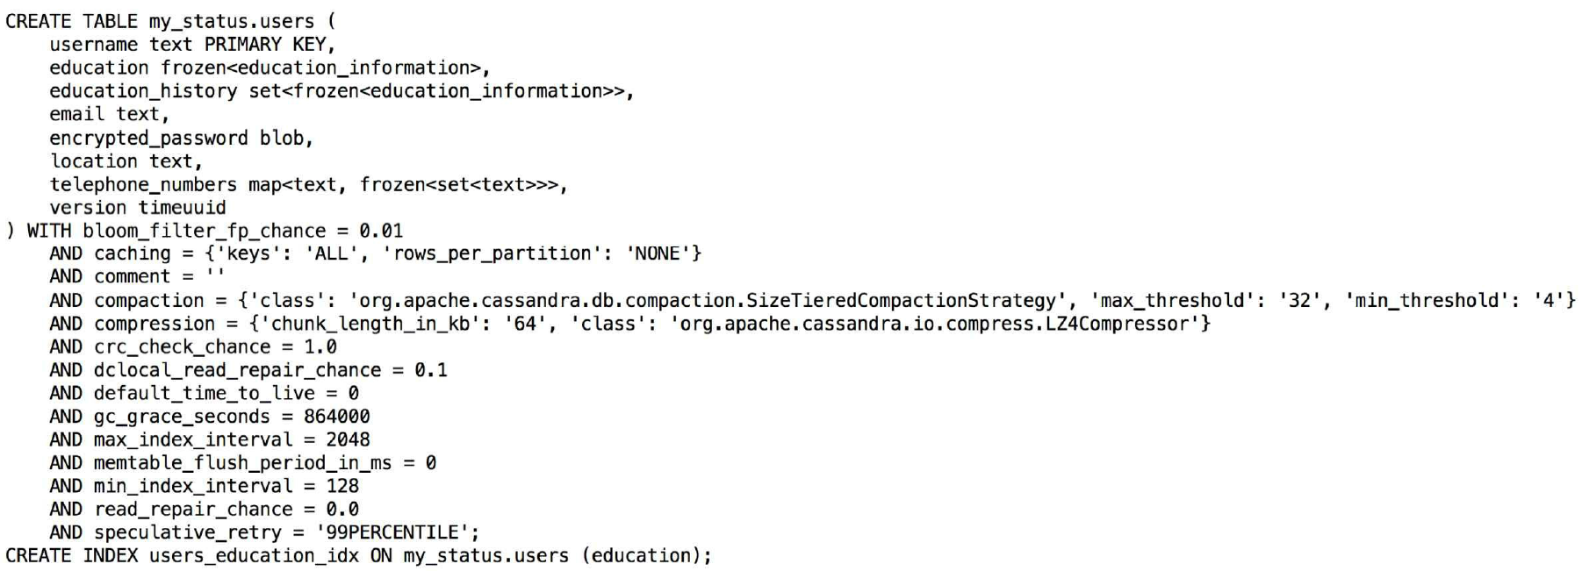
Table configuration options

Slide 71
Table properties
bloom_filter_fp_chance
Row caching
Key caching
Comment
Compaction
Compression
time_to_live
read_repair_chance
gc_grace_seconds
index_interval
memtable_flush_period
speculative_retry
Notes:
bloom_filter_fp_chance : You can configure the probability of getting the false positive result by setting bloom_filter_fp_chance. The tradeoff is that the lower the value of falsepositive probability, the higher the amount of memory the bloom filter will consume. So, you can set bloom_filter_fp_chance to 0 for no false positive result, which will result in the largest bloom filter array for the table. On the other hand, you can set it to 1, to say you want all false positive results, basically disabling the bloom filter. In practice, you would not want any of those extreme cases. The recommended and default value is 0.01 (if you choose LeveledCompactionStrategy, the default value get set to 0.1). Ideally, you wouldn’t touch this configuration unless you are really concerned about 10 percent reads that might be hitting the disk.
Compression: There are three compression algorithms available in Cassandra out of the box, LZ4Compressor, SnappyCompressor, and DeflateCompressor, in the decreasing order of read performance and increasing order disk space saving. So, why would one want a degraded performance for disk space? Consider a case where you have a table just for archival purposes.
time_to_live: You have seen previously in this chapter that you can set TTL for individual row or cell, but there may be cases where you want all the rows to be deleted after some time. For example, if you have a table that is used to aggregate data for the last 24 hours, you may just want to keep the data for the last 24 hours or may be a little bit longer. You can do this by specifying default_time_to_live in seconds when creating or updating a table. To disable TTL, set this property to 0. The default is zero.
read_repair_chance: The dc_local_read_repair_chance specifies the probability of performing a repair (making all replicas consistent) only in the data center that received the read request. If it is set to 0.25, every fourth read request will sync the whole data center. The default is 0.1. There is a global version of dc_local_read_repair_chance, that is, read_repair_chance. The read_repair_chance denotes the probability by which repairs across all the data centers take place. By default, this value is set to zero.
gc_grace_seconds: When a cell or a row is deleted, it is marked so by writing a tombstone. These tombstones aren’t immediately removed on compaction. Tombstones live till gc_grace_seconds before they become eligible to be removed.
index_interval: Each SSTable has an index summary loaded in the memory that keeps a sample of row keys index in that SSTable. Cassandra 2.0.x releases have a parameter named index_interval that basically dictates the number of primary key or row key skipped in the sample. The default value for this is 128
memtable_flush_period: Memtables are serialized to SSTable after a time period defined by this attribute. This represents the number of milliseconds after which a Memtable is forced to be flushed to the disk. The default is zero.
speculative_retry: Cassandra makes only as many requests as consistency level dictates. If a node dies during a read, Cassandra waits till timeout and then responds with a timeout error message. With speculative_retry, Cassandra avoids failure by sensing the unusual delay that a replica takes, and retries on a different replica. Here are the available settings:
ALWAYS: Cassandra reads from all the replicas and returns as soon as the consistency level is met.
Xpercentile: Retry triggers if the read operation takes more time than what the fastest X percent of reads took in the past. For example, if it is set to 99percentile, the retry will trigger if a read operation takes more time than the fastest 99 percent of the queries took.
Xms: Retry triggers if the read did not return after X milliseconds of sending the request. So, if you wanted a speculative retry to happen if a replica did not
respond in under 42 ms, set speculative_retry to 42 ms.
NONE: No retries.

Slide 72
Table configuration options
Caching: Key cache is used to store partition keys and their locations on disk in memory. Row cache is used to store entire partitions in memory along with the actual rows.
Compaction: Compaction is an internal mechanism used to get rid of excess data within Cassandra and merge multiple copies of the same partition (or row).
Compression: Data is compressed when it is written to the disk to reduce disk usage. This increases the CPU usage as well as read latency.
Default_time_to_live: This sets the TTL for the entire table. This can be overridden if you specify TTL while inserting a row into the table.
Gc_grace_seconds: This is the amount of time in seconds Cassandra waits before actually deleting tombstoned data.

Slide 73
COMPACTION
Compaction
SizeTieredCompactionStrategy : This favors a write-intensive load where updates are less frequent
LeveledCompactionStrategy : This strategy is good for the cases where data is mutated more frequently.
enabled: true/false
tombstone_threshold
Notes:
enabled: This takes a Boolean value. This property tells Cassandra to enable or disable compaction on the particular table. You would probably never want to disable it, so likely you are not going to use it.
tombstone_threshold: This is the ratio of cells (columns) in an SSTable that are eligible for deletion (garbage collectable) to the total number of columns in the SSTable. Essentially, it is the percentage of discarded columns in the SSTable expressed in decimal. By default, when 20 percent of SSTable columns become garbage collectable, it becomes a candidate for tombstone_compaction.
tombstone_compaction_interval: This is the minimum amount of wait time (in seconds) before the SSTable is considered for tombstone compaction. If tombstone_threshold is reached, the SSTable is compacted; otherwise, Cassandra retries again after tombstone_compaction_interval. So, it may not be wise to set this value too small. The default is 86400 seconds (one day).
unchecked_tombstone_compaction: If the data from the partition that the tombstone belongs to exists in other data files, the tombstone cannot be discarded; it works as an indicator of deletion. This check is performed every time before a tombstone compaction is attempted. This is extra work and is exactly why you would not want to keep tombstone_compaction_interval too low. By setting this option as true, you are telling Cassandra to try to compact without performing this check. Compaction may fail in this case, but if you have a situation where you have immutable rows that get discarded as a whole, you may opt for this option.
min_sstable_size (specific to SizeTieredCompactionStrategy): This defines SSTables of similar sizes into one big SSTable. So, one can think of the compaction process as bucketed or batch process where SSTables that fall into one bucket get merged into one. If your SSTables are really small, you may end up in many tiny buckets, which may be inefficient. min_sstable_size is to specify the minimum size of SSTable, below which, all the SSTables are assumed to be in one bucket and compacted. The unit of min_sstable_size is bytes and the default value is 50 MB.
min_threshold and max_threshold (specific to SizeTieredCompactionStrategy): This defines the minimum number of similar sized SSTables to start compaction. max_threshold is the maximum number of SSTables to consider in a compaction process. The default value of min_threshold is 4 and the default value of max_threshold is 32.
bucket_high and bucket_low (specific to SizeTieredCompactionStrategy): When we mentioned similar sizes in the previous point, what we meant is explained here. A set of SSTables are assumed to be in the same bucket to be compacted if their size lies within the range described by this formula: [average_size*bucket_low, average_size*bucket_high]. Ideally, bucket_low should be a positive decimal fraction value less than one, and bucket_high is a decimal fraction more than one. Default values for bucket_low and bucket_high are 0.5 and 1.5 respectively.
cold_reads_to_omit (specific to SizeTieredCompactionStrategy): Cassandra keeps track of which SSTable contributes to how many reads. So there may be cases where some SSTables contribute very little to nothing to the reads. It may not be worth the additional effort to compact those “cold” SSTables because they are accessed once in a while. For example, you have a table that has total 200 reads per second overall, of which 100 are contributed by SSTable S1, 85 by S2, 10 by S3, and 5 by S4. If you have cold_reads_to_omit as 0.1, then SSTables that cumulatively
contribute to 200*0.1 or 20 reads will not be considered for compaction. Adding from the tiniest ones, S4 and S3 contribute to only 15 reads per second, so they will not be considered a candidate for compaction. Values for cold_reads_to_omit can be anything between 0.0 and to 1. However, you would not want to set it to 1, ignoring all the SSTables. Setting it to zero disabled discriminating the SSTables’ eligibility to compact based on its contribution in reads. The default in Cassandra 2.1 and onwards is 0.05 and in the previous versions it is 0.
sstable_size_in_mb (specific to LeveledCompactionStrategy): This is the target size for SSTable in LeveledCompactionStrategy. Cassandra tries to keep SSTable size less than or equal to this value, but SSTable may be larger than this value in exceptional cases where a partition key holds very large data. The default value is 160 MB.

Slide 74
Compression properties
Compression:
LZ4Compressor
SnappyCompressor
DeflateCompressor
Notes:
chunk_length_kb : A chunk is the minimum quantum of data that is read by Cassandra. Depending on how much data is read on an average and the mean size of the rows of the table, this property may be tweaked. The higher value for this may improve compression performance, but it will also increase the minimum size of data read. In general, you wouldn’t touch the default value of 64, unless you are familiar with data and its access pattern in the future.
crc_check_chance : Cyclic Redundancy Check or CRC is a way to validate if the uncompressed data is exactly the same as the original. In cases when you have compression enabled for a table, each compressed block holds a checksum for CRC to avoid any data corruption. This property tells the probability by which reads are verified for any errors. By default, it is set to 1, so all reads are first validated for data integrity. If it is set to 0.25, every fourth read is validated.

Slide 75
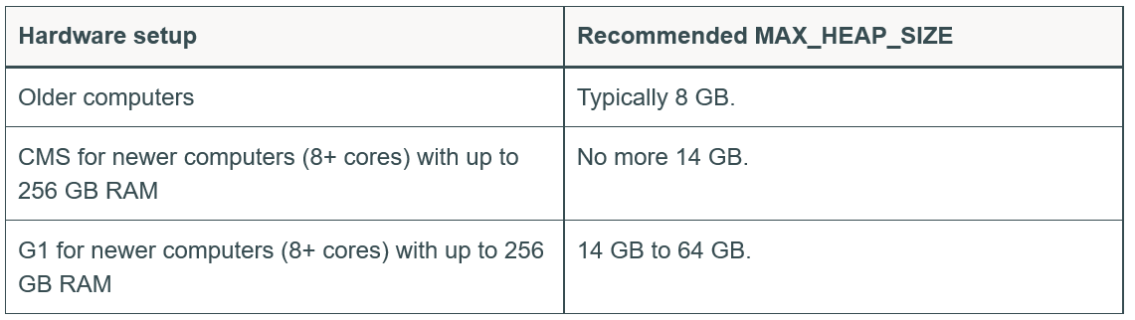
Java Heap Setting
http://docs.datastax.com/en/cassandra/3.0/cassandra/operations/opsTuneJVM.html

Slide 76
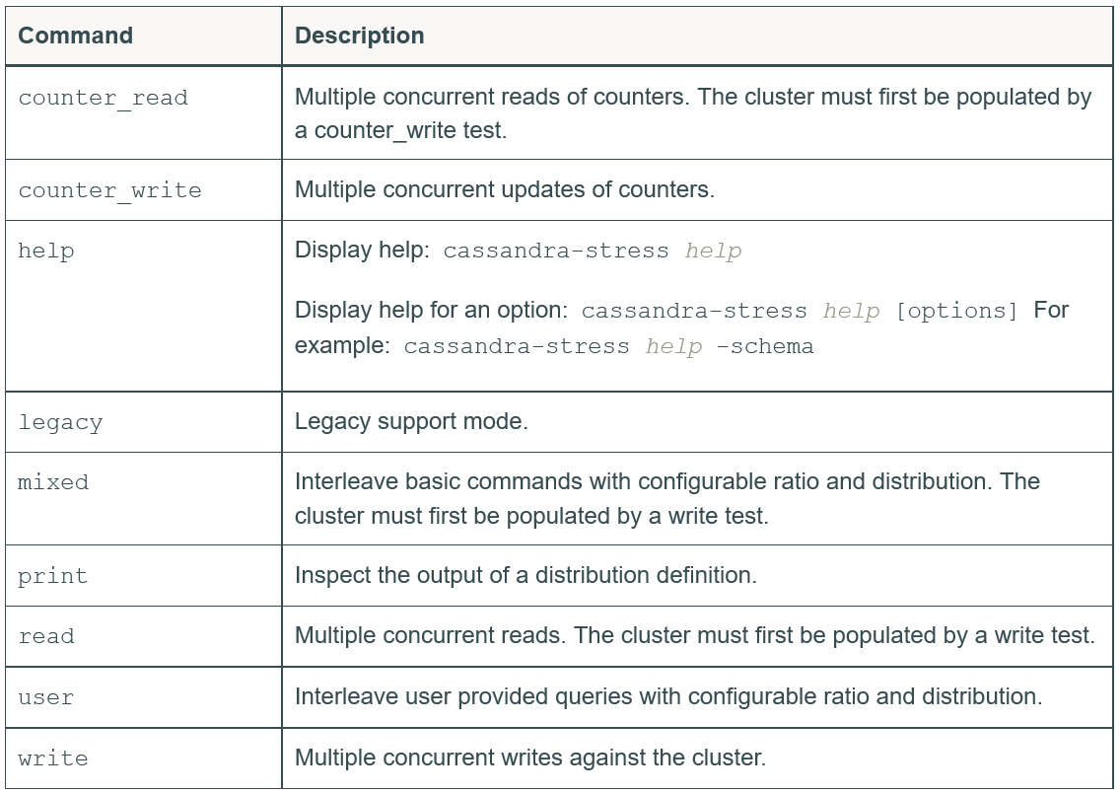
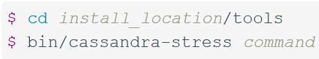
cassandra-stress Tool
http://docs.datastax.com/en/cassandra/3.0/cassandra/tools/toolsCStress.html

Slide 77
Nodetool
Cfstats
Netstats
Status
Ring
Notes:
cfstats
The term cfstats stands for “column family statistics”. It comprises details about every significant statistic regarding all the tables in the ring and across all the keyspaces.
netstats
The netstats command is used to view the network statistics (streaming information) of the node within the ring.
status
The status command is a general ring health check and it gives a human-readable summary of the cluster.
ring and describering
The ring and describering commands are more fine-grained versions of status. They provide information at the virtual node level
tpstats
The term tpstats stands for “thread pool statistics”. This is an important measure of how much pressure the node is bearing at a given instant. You can see task counts that are running, pending, completed, and blocked in various stages.
compactionstats
The compactionstats command shows the compaction process running in the instant. Compaction is a CPU- and I/O-intensive task. It may temporarily increase used disk space.
info
The info command prints an overall bird’s-eye view of the node’s health. This command can be used to get a quick summary of the node.

Slide 78
Application Development
The Java driver provides many capabilities:
Node discovery: Java driver automatically discovers new nodes that join the cluster and redirects queries to them based on the load-balancing policy you choose
Load balancing: Java driver provides a bunch of load balancing policies to evenly spread out queries
Async execution: Java driver allows asynchronous execution of queries allowing multiple simultaneous requests
Retry policy: Java driver also provides several retry policies to retry failed queries
Prepared statements: This feature reduces the data sent over network

Slide 79
Cluster API
Cluster: This represents a Cassandra cluster. This is the main entry point when connecting to a cluster.
Cluster.Builder: This can be used to build a Cluster object.
Configuration: This holds cluster configuration.
Host: This represents a Cassandra node.
KeyspaceMetaData: This holds keyspace metadata.
MetaData: This holds metadata about the cluster

Slide 80
Querying
PreparedStatement: This represents a prepared statement
Query: This represents a query
BoundStatement: This is created from a prepared statement with the values bound
Sessions: This creates a connection to a Cassandra cluster and is used to execute queries
ResultSet: This denotes the result of a query
Row: This is a single CQL row

Slide 81
QueryBuilder API
QueryBuilder API provides another way to execute queries without using prepared statements
Methods to select/insert/update/delete: select() and update(String table)
Methods representing a WHERE clause: eq(String name, Object value)
Methods representing an assignment: set(String name, Object value)

Slide 82
Asynchronous Querying
executeAsync()
ResultSetFuture
getUninterruptibly()

Slide 83
Driver policies
Load-balancing policy: This determines which Cassandra host to contact for each query.
Retry policy: This determines the course of action whenever failures occur. It's usually triggered when a timeout or host unavailable exception happens.
Reconnection policy: This policy decides how often reconnection to a dead node is attempted

Slide 84
Load-balancing policy
Cluster cluster = Cluster.builder().addContactPoints("127.0.0.1")
.withLoadBalancingPolicy(LoadBalancingPolicy policy).build();
RoundRobinPolicy
This is the default load-balancing policy
This implementation is not datacenter aware
DCAwareRoundRobinPolicy
This policy is datacenter aware and routes queries to the local nodes first
TokenAwarePolicy
This policy adds token awareness on top of another policy
Notes:
Cluster cluster = Cluster.builder().addContactPoints("127.0.0.1").withLoadBalancingPolicy(new RoundRobinPolicy()).build();
Cluster cluster = Cluster.builder().addContactPoint("127.0.0.1")
.withLoadBalancingPolicy( DCAwareRoundRobinPolicy.builder()
.withLocalDc("localDc")
.withUsedHostsPerRemoteDc(2)
.allowRemoteDCsForLocalConsistencyLevel()
.build()).build();
Cluster cluster = Cluster.builder().addContactPoints("127.0.0.1").withLoadBalancingPolicy(new TokenAwarePolicy (new RoundRobinPolicy())).build();

Slide 85
Retry Policy
Cluster cluster = Cluster.builder().addContactPoints("127.0.0.1")
.withRetryPolicy(RetryPolicy policy).build();
Java driver provides a set of policies to ensure queries are retried a certain number of times before throwing exceptions
DefaultRetryPolicy: This policy retries a failed query a certain number of times. It retries queries on a read timeout where replica nodes were contacted but the read failed. It also retries queries on a write timeout when writing distributed log for batches.
DowngradingConsistencyRetryPolicy: This ensures that a failed query may be retried with a consistency level lower than the initial query.
FallthroughRetryPolicy: This never retries any query, and you implement retry logic in your application code.

Slide 86
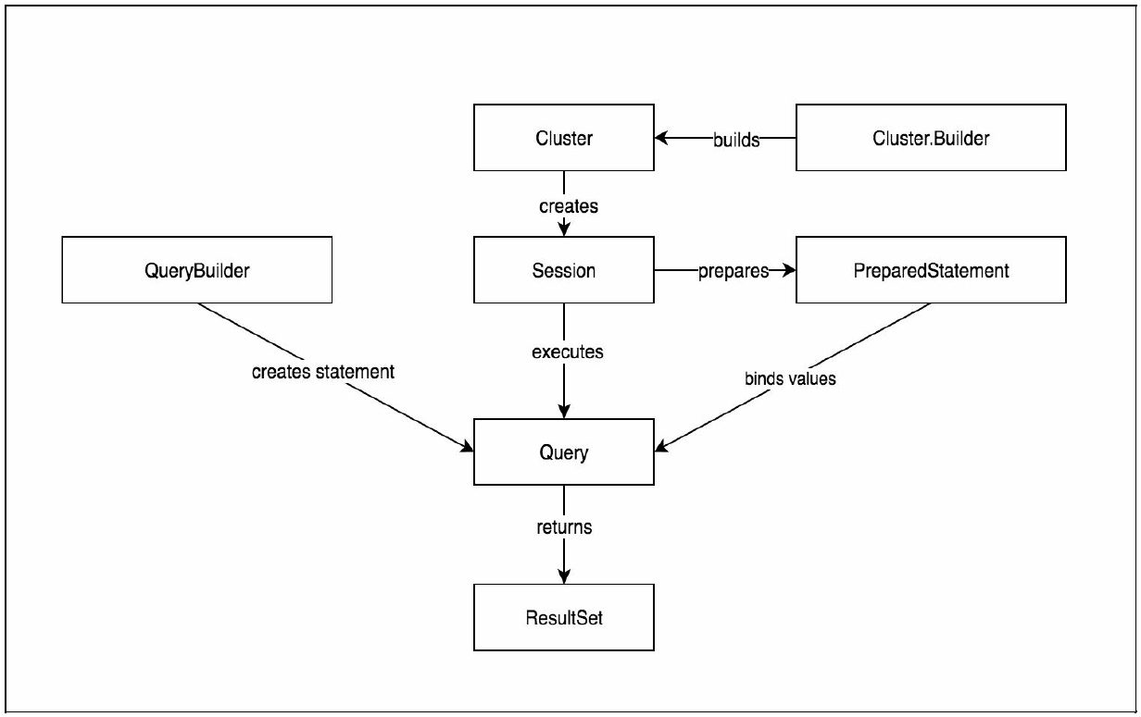

Slide 87
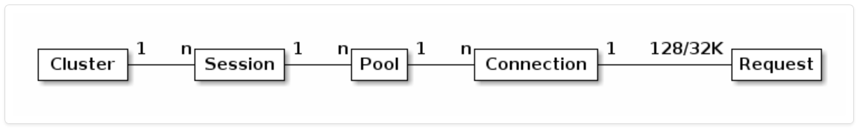
Connection Pooling
Cluster cluster = Cluster.builder()
.withContactPoints("127.0.0.1")
.withPoolingOptions(poolingOptions)
.build();
PoolingOptions poolingOptions = cluster.getConfiguration().getPoolingOptions();
poolingOptions
.setCoreConnectionsPerHost(HostDistance.LOCAL, 4)
.setMaxConnectionsPerHost( HostDistance.LOCAL, 10)
.setCoreConnectionsPerHost(HostDistance.REMOTE, 2)
.setMaxConnectionsPerHost( HostDistance.REMOTE, 4);

Slide 88
Cassandra Data Modeling
Denormalize, denormalize, and denormalize: Forget about old school 3NF in Cassandra; the fewer the network trips, the better the performance. Denormalize wherever you can for quicker retrieval.
One row, one machine: Each row stays on one machine. Rows are not sharded across nodes.
From query to model: Unlike RDBMS, where you model most of the tables with entities in the application and then run analytical queries to get data out of it, Cassandra has no such provision. So you may need to denormalize your model in such a way that all your queries stay limited to a bunch of simple commands such as get, slice, count, multi_get, and some simple indexed searches.

